Slide 1

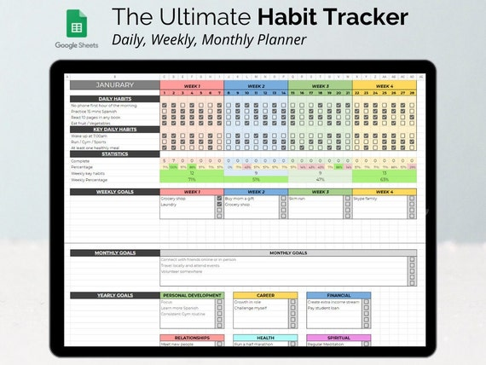
Personal Habit Tracker
Prof : Bon Sy
Software Engineering (CS370)
Queens College – Sprint 2025 Group
Presented By: Mohamed, Andrew, Asfandyar & Shiwlee

Slide 2

What is Personal Habit Tracker?
An easy-to-use app to help people stay healthy, organized, and motivated.
Designed for students, professionals, and anyone building better daily routines.
Tracks goals, provides reminders, and shows visual progress with charts and streaks.

Slide 3
UI Features and Visual Feedback
- Habit list with goal type, target, and progress bars
- Goal achieved messages
- Weekly progress charts (Chart.js)
- Reminders toggle and notifications

Slide 4
Stakeholder Requirements Overview
1. Users can create, edit, and delete habits, with goal types (daily/weekly).
2. Users can view progress with charts, streaks, and motivational feedback.
3. Users receive reminder notifications at the right time.

Slide 5

Key Software Requirements
1. User can create, edit, or delete a habit.
2. User can set a daily or weekly goal during creation/edit.
3. Streak counter updates on completion.
4. Dashboard shows charts for progress and streak history.
5. Motivational message appears when goals are met.
6. Reminders notify user based on selected time.

Slide 6
Team Contributions Across Sprints Sprint 1
Sprint 1 (Setup & QA):
- Asfandyar : Scrum Master
- Mohamed: Backend setup
- Andrew: Frontend setup
- Shiwlee: QA, interviews, Kanban setup
Deliverables: • GitHub Project Kanban board created and organized • Project folders structured • Roles defined and documented • Initial components added to backlog • Team onboarded with tech stack & feature scope

Slide 7
Sprint 2
Sprint Goal: Implement core CRUD functionality for creating, editing, and deleting habits using local Storage. Team Roles: • Shiwlee – Scrum Master • Asfandyar – Front-End Developer • Mohamed – QA / Testing • Andrew – Backend Developer
Deliverables: • Form for adding new habits • Edit and delete buttons added to each habit entry • Habits stored and retrieved from local Storage • Basic UI/UX design applied • Functional testing on add/edit/delete logic

Slide 8
Sprint 3
Sprint Goal: Enable users to set daily or weekly goals and track them with simple counters or checkboxes. Team Roles: • Andrew – Scrum Master • Shiwlee – Backend Developer • Asfandyar – QA / Testing • Mohamed – Front-End Developer
•Deliverables: • Option to set numeric daily/weekly goals for each habit • Checkbox or counter UI for marking progress • Local goal progress tracking using localStorage • Display progress (e.g., “2 out of 4 done”) • Validation and testing for input and tracking

Slide 9
Sprint 4
Sprint Goal: Add motivating visuals like streak counters and weekly progress charts using a simple library.
Team Roles: • Mohamed – Scrum Master • Andrew – QA / Testing • Shiwlee – Front-End Developer • Asfandyar– Backend Developer
Deliverables: • Display streak count for habits (e.g., “3 days in a row!”) • Integrate a basic chart (e.g., Chart.js) to show progress over time • Add visual fun elements like emojis or colors • Confirm data loads accurately from localStorage • Testing across different devices/resolutions

Slide 10
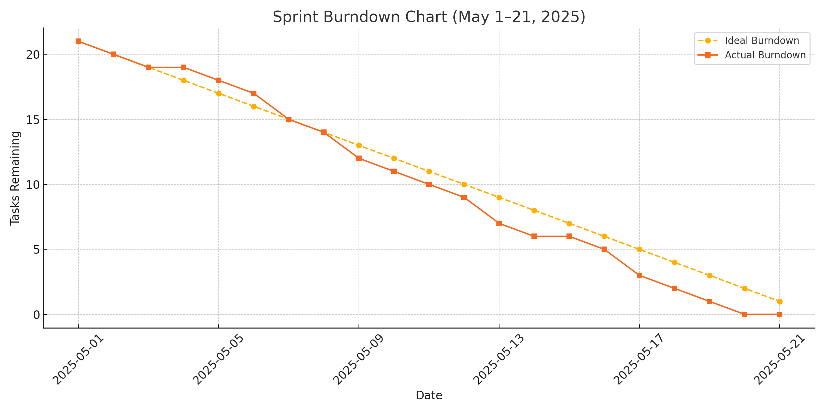
Brundown Chart

Slide 11
Database Schema Overview
users table: id, username, password
•habits table: id, username, name, goal, type, completions, last_completed
Linked by username field
Stores habit progress and user authentication details

Slide 12
Java Servlet: HabitTrackerServlet.java
Handles login and signup with sessions
Receives POST requests for add/edit/delete habits
Uses JDBC to connect to remote MySQL database
Manages habit logic (goal type, name, completions)
Redirects user to index.html after operations

Slide 13
Frontend Integration (UI & Charts
HTML form collects habit name, goal, and type
Sends POST to /HabitTrackerServlet using form submit
Data displayed in habit table with delete/edit buttons
Chart.js used to visualize weekly progress
Notifications handled via checkbox toggle (reminder logic)

Slide 14
Testing and Validation
Signup/Login: Session created and validated
Add Habit: Inserts correct values in DB
Edit Habit: Goal/type updated correctly
Delete Habit: Entry removed from DB
UI: Motivational message when goal met
Reminder Toggle: Saves and shows configured time

Slide 15
Project Outcome & Challenges
Deliverables:
Fully functional CRUD with database
Daily/Weekly goal selection with progress tracking
Visual feedback using Chart.js and messages
Reminder feature added for daily tracking
Challenges:
- Switching tech stack ( MySQL)
- Coordination of frontend/backend roles
- Visual chart integration and real-time

Slide 16
Final Steps and Demo
- Visit: http://207.38.227.166/Final_370_PersonalHabitTracker/Homepage.html
- Log in / Sign up and test your habits
- Final testing, documentation, and polish by May 22

Slide 17
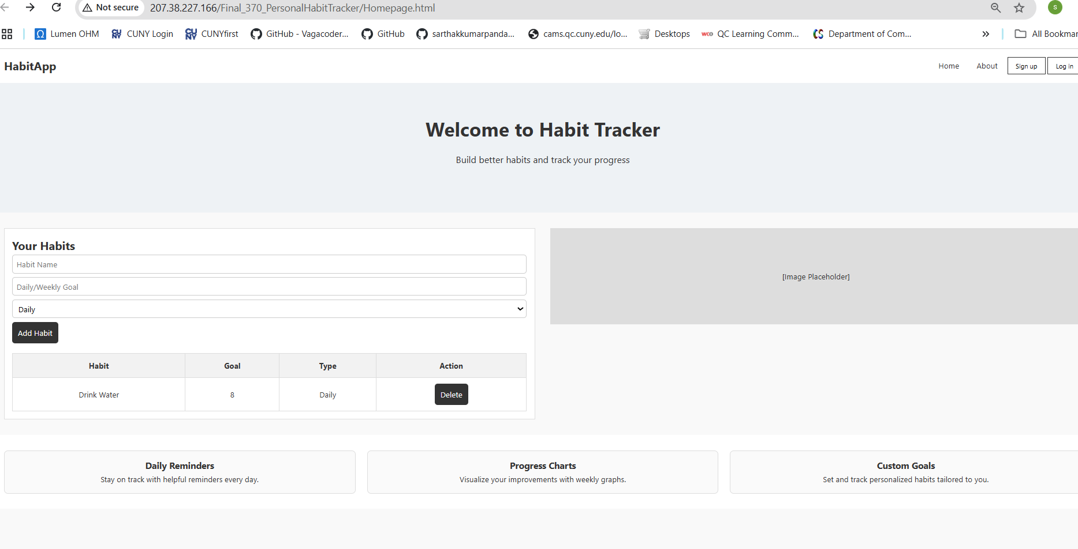
System Architecture Overview

Slide 18

Thank you
Thank you for your time and guidance throughout the semester.
Working on the Personal Habit Tracker helped us grow as a team and learn real-world software development skills — from backend integration to user-centered design. We look forward to your feedback and hope you enjoyed our presentation!
👩‍💻👨‍💻 – Team Habit Tracker

